Slide 1
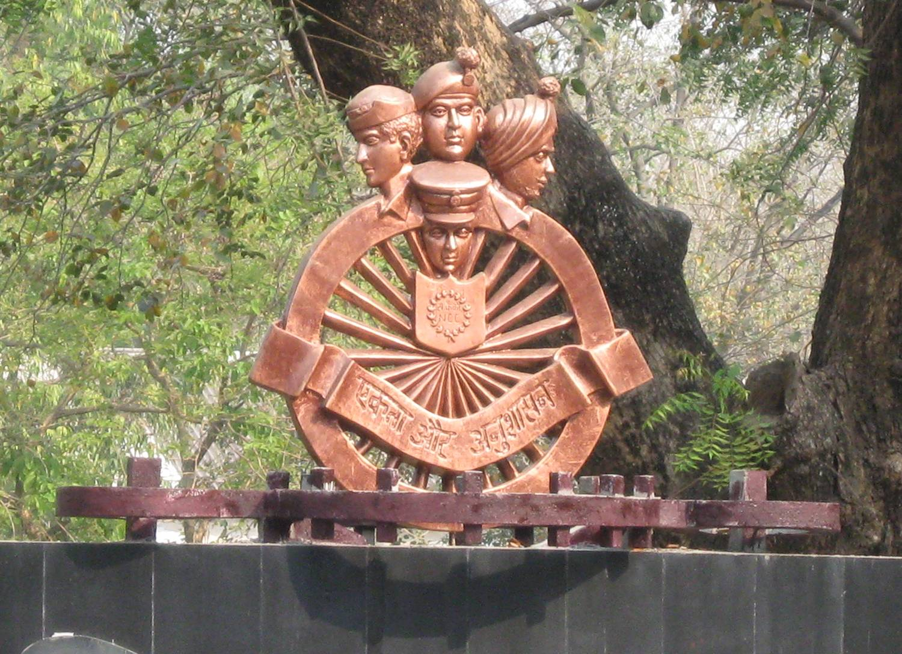



Slide 2
OFFICERS TRAINING ACADEMY
HISTORY, ORG
&
FUNCTIONING OF
NCC OTA

Slide 3
INTRODUCTION
THE YOUTH OF THE COUNTRY IS A NATIONAL
ASSET AND ITS DEVELOPMENT IS A TASK OF
GREAT SIGNIFICANCE AND IMPORTANCE.
THE NCC HAS GOT EXPERTISE AND BUILT-IN
INFRASTRUCTURE TO FULFIL THIS GOAL ON
BEHALF OF THE NATION
OVER THE YEARS NCC OTA HAS CONTRIBUTED TOWARD THE GOAL IN AN EFFECTIVE AND MEANINGFUL MANNER

Slide 4
AIM
TO ACQUAINT ALL WITH THE HISTORY, ORGANISATION
AND FUNCTIONING OF NCC OTA

Slide 5
PREVIEW
PART - I HISTORY, AIMS OF
NCC & ROLE OF NCC OTA
PART - II ORG OF NCC OTA
PART - III COURSES AT NCC OTA
CONCLUSION

Slide 6
HISTORY, AIMS OF NCC & ROLE OF NCC OTA
PART I

Slide 7
BRIEF HISTORY
BRIEF HISTORY
NCC OTA EST ON 01 MAR 1957.
FORMALLY INAUGURATED ON 06 MAY 1957 BY THEN DY DEF MINISTER SARDAR SURJIT SINGH MAJITHIA.
GIRLS WING FOR LADY OFFRS ADDED TO THE ACADEMY IN AUG 1959. LATER SHIFTED TO GWALIOR IN APR 1965 AND IS NOW KNOWN AS WOTA, GWALIOR.
THE NCC ACADEMY AT PURANDHAR WAS MERGED WITH THIS ACADEMY ON 31 MAR 1979.
THE ACADEMY SINCE INCEPTION HAS BEEN CONDUCTING PRE-COMMISSION COURSE, REFRESHER COURSES, ORIENTATION COURSES AND TRG SELECTED NCC CADETS FOR SSB.

Slide 8
AIMS OF NCC
AIMS OF NCC
To Develop Character, Comradeship, Discipline, Leadership, Secular Outlook, Spirit of Adventure, and Ideals of Selfless Service amongst the Youth of the Country.
To Create a Human Resource of Organized, Trained and Motivated Youth, To Provide Leadership in all Walks of life and be Always Available for the Service of the Nation.
To Provide a Suitable Environment to Motivate the Youth to Take Up a Career in the Armed Forces.

Slide 9
ROLE OF NCC OTA
PRE-COMMISSION TRAINING TO TEACHING STAFF DRAWN FROM VARIOUS COLLEGES AND SCHOOLS FOR COMMISSIONING THEM AS ANOs.
REFRESHER TRAINING TO ANOs SO AS TO ENHANCE THEIR PROFICIENCY.
ORIENTATION TRAINING FOR JCOs AND NCOs POSTED TO NCC UNITS.
ORIENTATION CADRE FOR OFFRS POSTED TO NCC UNITS

Slide 10
ORG OF NCC OTA
PART II

Slide 11
ORG : NCC OTA
COMDT
DY COMDT
ADM OFFR
ADJT
QM
RMO
TRG WING DEMO PL ADM WING QM SEC
SHIVAJI ARJUN RANA PRATAP A B C
COY COY COY MESS MESS MESS
Instr Cl ‘A’(Coy Cdr) Instr Cl ‘A’(Coy Cdr) Instr Cl ‘A’(Coy Cdr)
Instr Cl ‘B’-03 Instr Cl ‘B’-02 Instr Cl ‘B’-02

Slide 12
COURSES AT NCC OTA
PART III

Slide 13
COURSES
PRE COMMISSION TRG
Courses Capacity No of courses Duration
per year
PRCN SD 125 02 03 Months
PRCN JD 125 02 03 Months
PRCN/AF/NAVY 40 01 21 Days #
PERSONALITY DEVELOPMENT COURSE 102* 02 10 Days
# CONDUCTED WITH PRCN SD/JD FOR FIRST 3 WEEKS.
* 06 CANDIDATES FROM EACH DTE.

Slide 14
REFRESHER COURSES
Courses Capacity No of Courses Duration
Per Year
Refresher DC(SD/JD) 130* 02 03 Months $
Refresher Sr Div 130 08 01 Month
(Pt I - 65, II -65)
Refresher Jr Div 120 12 01 Month
(Pt I-50,II-35,III-35)
$ Run concurrently with PRCN Course * 50 (Jul-Oct) & 80 (Nov-Feb)

Slide 15
ORIENTATION COURSES
Courses Capacity No of courses Duration per year
JCOs 110** 07** 13 Days
NCOs 110@ 26 13 Days
NCOs/Drill 32 02 10 Days
O/PI/AF/NAVY 40 09 13 Days
Total No of Courses - 44
** 770 JCOs
@ 2860 NCOs.

Slide 16


SR NO | COURSE | NO OF COURSES | DURATION | COURSE CAPACITY (APPROX) | TOTAL | REMARKS
1 | PRCN/SD | 02 | 90 Days | 125 | 250
2 | PRCN/JD | 02 | 90 Days | 125 | 250
3 | REF/SD/JD/PT-I/DC | 02 | 90 Days | 50+80 | 260 | SD-50 & JD-80
4 | PRCN/AF/NAVY | 01 | 20 Days | 40 | 40
5 | REFRESHER SD PT-I & II |  | 30 Days | 60 | 240 | 30 for Pt-I and Pt-II respectively
6 | REFRESHER JD PT-I, II & III |  | 30 Days | 120 | 480 | 50 for Pt-I and 35 each for Pt-II and Pt-III.
7 | NEW ENTRANT OFFRS CADRE | 04 | 06 Days | 25 | 100
8. | PIOC | 26 | 13 Days | 220 | 5720
9. | O/PI/AF/NAVY | 12 | 13 Days | 40 | 480
10 | SSB SCREENING COURSE | 02 | 10 Days | 102 | 204
11 | DRILL COURSE NCOS | 02 | 11 Days | 32 | 64
12 | PARASAILING CADRE | 03 | 10 Days | 68 | 204 | 03 x NCOs & 01 x Dvr from each Dte.
 | TOTAL | 59 |  |  | 8292
03

Slide 17
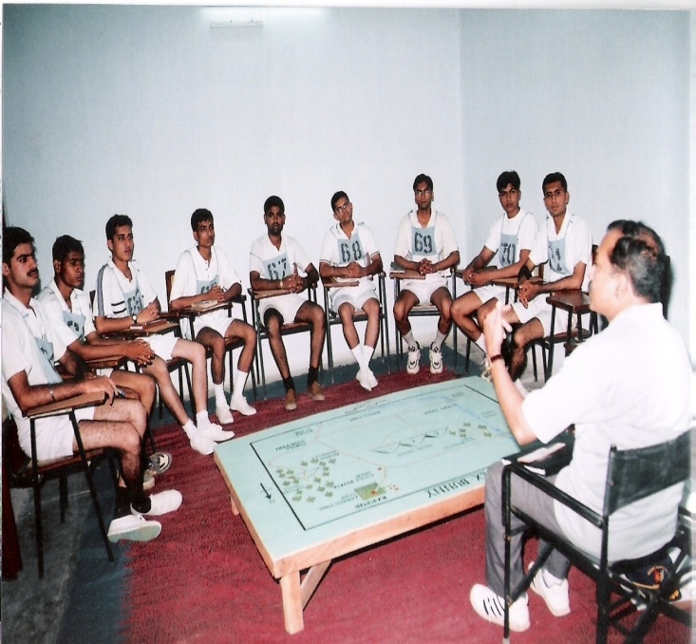
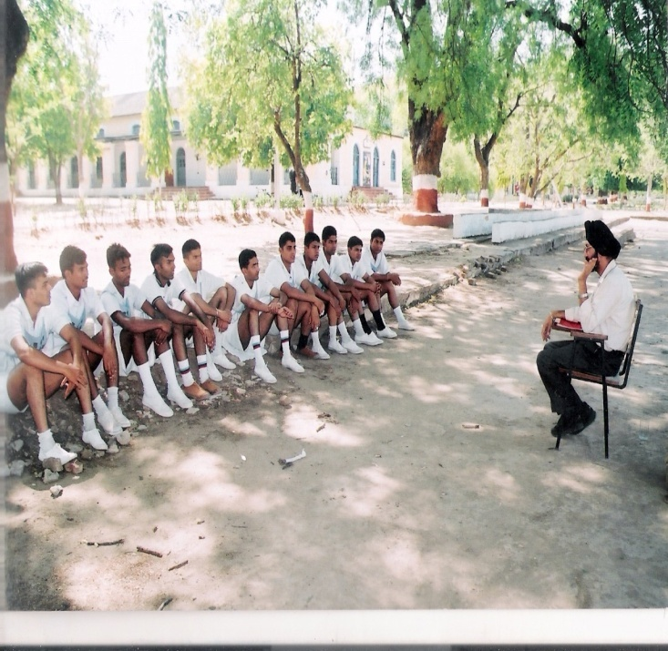
PERSONALITY DEVELOPMENT COURSE
TO ASSESS PERSONALITY OF A CADET BY A TEAM OF EXPERT GTOs/IOs/PSYCHOLOGISTS TO FAMILIARIZE NCC CADETS WITH ALL THE TESTS/TASKS AS EXISTING AT VARIOUS SSBs.
GUIDE THE CANDIDATES WITH A VIEW TO ENHANCE THEIR POTENTIAL.
IMPROVE THEIR GENERAL AWARENESS.

Slide 18
CONCLUSION

Slide 19
BLOCK SYLLABUS : PRCN COURSES
Ser No | Subject | No of Pds Allotted | Weightage (%)
1. | PT | 67 | 11.31
2. | Drill | 160 | 27.02
3. | Rif 7.62mm | 41 | 7.92
4. | LMG 7.62mm | 14 | 2.36
5. | SMC 9mm | 08 | 1.35
6. | Wpn Trg Gen | 15 | 2.53
7. | Fd Trg, Fd Craft, Battle Craft | 16 | 2.70
8. | Tactics | 17 | 2.87
9. | Map Reading | 47 | 7.93
10. | Field Engineering | 08 | 1.35

Slide 20
Ser No | Subject | No of Pds Allotted | Weightage (%)
11. | Leadership Trg | 18 | 3.04
12. | Adventure Trg | 32 | 5.40
13. | Social Service | 13 | 2.19
14. | Methods of Instrs | 20 | 3.37
15. | Camp Craft | 24 | 4.05
16. | Medical | 20 | 3.37
17. | Hygiene and Sanitation | 04 | 0.68
18. | Civ Def | 07 | 1.18
19. | Org & Adm | 35 | 5.91
20. | NCC Subjects | 19 | 3.20
21. | Life saving | 04 | 0.68
22. | Spare | 07 | 1.18
 | TOTAL | 592 | 100

Slide 21
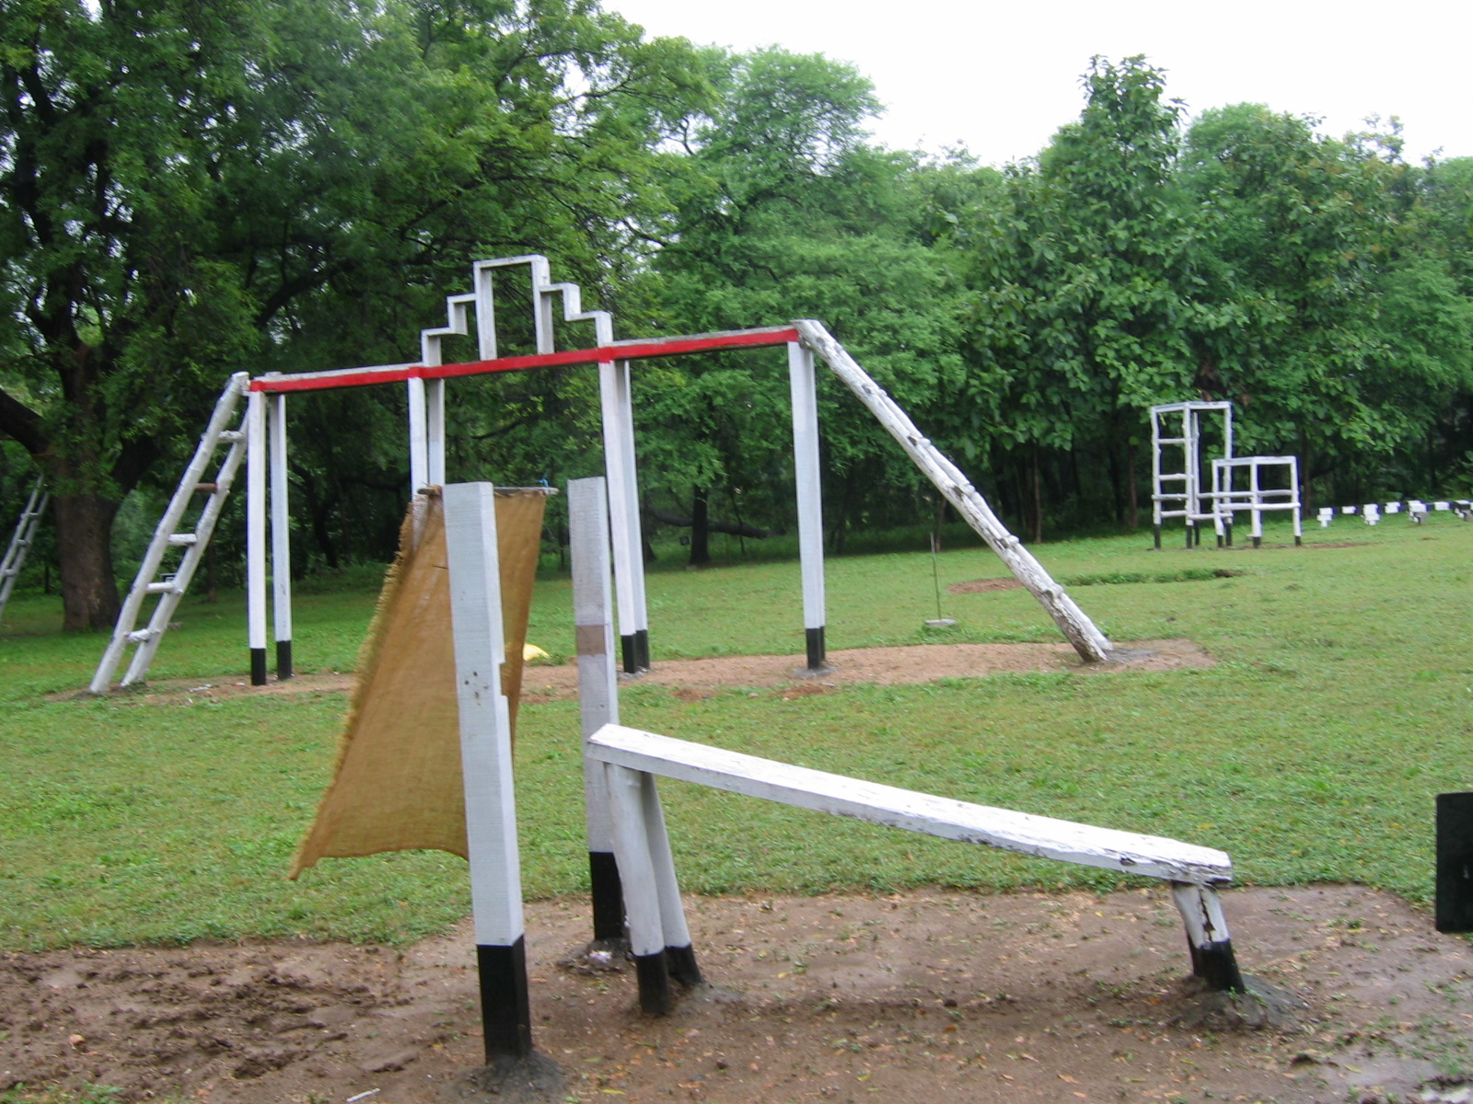
BLOCK SYLLABUS : PERSONALITY EVELOPMENT COURSE
Ser No | Subject | No of Pds Allotted | Weightage (%)
1. | Initial Briefing | 02 | 3
2. | Screening | 05 | 7
3. | GTO Technique | 14 | 18
4. | IO Technique | 14 | 18
5. | Psychological Technique | 14 | 18
6. | OTW (Focus on communication and gen awareness) | 14 | 18
7. | Analysis of performance | 14 | 18
 | Total | 77 | 100

Slide 22
BLOCK SYLLABUS :
O/NCOs/DRILL
Ser No | Subject | No of Pds Allotted | Weightage (%)
1. | Foot Drill | 26 | 38.23
2. | Rifle Drill | 24 | 35.29
3. | Cane Drill | 03 | 4.41
4. | Sword Drill | 03 | 4.41
5. | Colour Drill | 02 | 2.94
6. | Misc | 10 | 14.70
 | Total | 68 | 100

Slide 23
IMPORTANT TRG ACTIVITIES
MAP READING
- EX TREASURE HUNT (Pt to Pt March)
FIELD CRAFT
- EX SHIVIR STHAPANA I (SMD)
- EX SHIVIR STHAPANA II (EST OF CAMP)
ADVENTURE TRG
- CYCLE EXPEDITION TO THERMAL POWER STATION, KORADI/WCL COLLIERIES.
GUEST LECTURES/SEMINAR
- BY PRAHAR SAMAJ JAGRUTI SANSTHA, NAGPUR
- BY NATIONAL CIVIL DEFENCE COLLEGE, NAGPUR

Slide 24
IMPORTANT TRG ACTIVITIES
LECTURETTES AND PRESENTATIONS ON CURRENT TOPICS BY TRAINEES
DRILL & WT COMPETITION
CULTURAL PGME/ QUIZ COMPETITION
GAMES COMPETITION
  BASKETBALL
  HANDBALL
  VOLLEYBALL

Slide 25
AIMS OF COURSES
  Pre-Commission Sr/Jr Div and Refresher DC PT-I
  To impart basic mil trg to Offr Cadets from colleges /schools so as to enable them to plan and supervise trg in NCC units as ANOs.

Slide 26
PRCN Air Force / Navy
To impart basic mil trg to offr cadets of Air wing / Naval wing, give them an exposure to Army service and to imbibe NCC ethos to enable them to guide & supervise trg of NCC (Air wing / Naval wing) cadets in their units.

Slide 27
REFRESHER SR DIV & JR DIV COURSES :
To impart trg to Associate NCC Offrs of the SD/JD so as to :-
* Improve their all round performance .
* Enable them to acquire proficiency in imparting instrs .
* Assess their suitability for promotion .

Slide 28
  O/JCOs/NCOs :
  To impart orientation trg so as to enable JCOs / NCOs to function effectively as instrs in NCC Units.

